Slide 1
Finding Location of a Picture When Taken

Slide 2
Different Possibilities
libexif – A c++ library file that can pull the exif data from an image
Google Maps API – HTML API to track and find out location
Device GPS – Using the device’s GPS hardware
Bluetooth – Using device’s Bluetooth technology
Wi-Fi – Using wireless networks

Slide 3
Pros and Cons of libex
Pros:
  Can pull very detailed information from a picture
  Open source file
  Fast
  Windows
Cons:
  Can’t pull much from a PNG
  Only can be used with Windows
  Can be lots of work

Slide 4
Pros and Cons of Goggle Maps API
Pros:
  Easy to code
  Used across multiple browsers
  Very accurate
  Shows location on actual map
Cons:
  Has to have internet access
  Doesn’t include information such as focal length
  User needs to allow access if not already allowed

Slide 5
Pros and Cons of Device GPS
Pros:
  Mostly on every device
  Barely Unavailable
Cons:
  Can track very accurately
  Can not function without service or Wi-Fi

Slide 6
Pros and Cons of Bluetooth
Pros:
  Almost every modern device has Bluetooth technology
  Easy to access
Cons:
  May not be as accurate
  May require additional hardware
  Needs connection
  Connection is usually short ranged
  Easily interfered

Slide 7
Pros and Cons of Wi-Fi
Pros:
  A lot of areas have Wi-Fi access
  Hardware for Wi-Fi access is on every mobile device
  Networks can be reliable
Cons:
  Have to be in an area where Wi-Fi connection is available
  The location isn’t completely accurate
  Wi-Fi may have some security issues

Slide 8
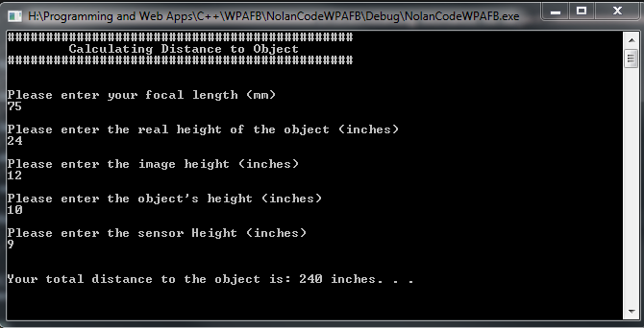
Formula for Calculating Distance with data
Distance to Object = ( focal length x image height x real height ) / ( object height x sensor height )

